Slide 1

Turkmenistan – Afghanistan – Pakistan
500 kV power transmission line project

Slide 2
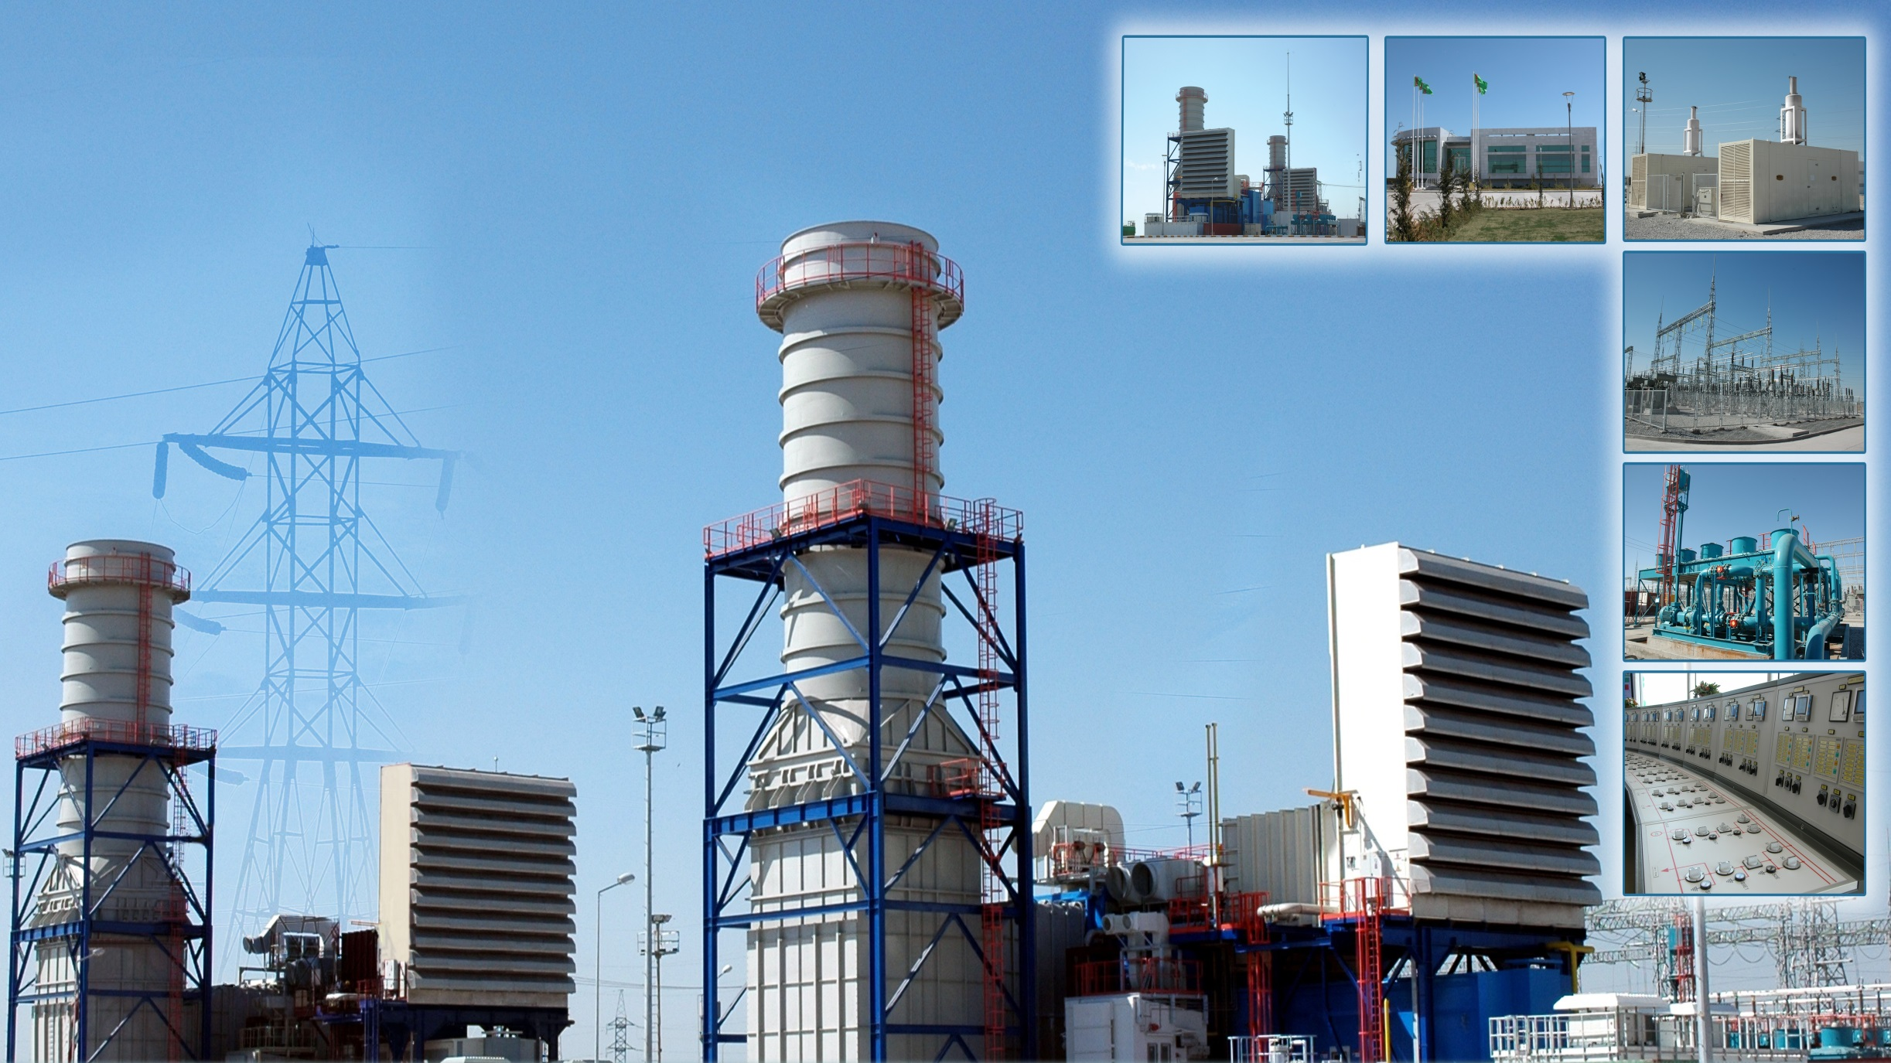
Power sector of Turkmenistan
6500 MW installed capacity
3700 MW local demand
2800 MW available for export

Slide 3
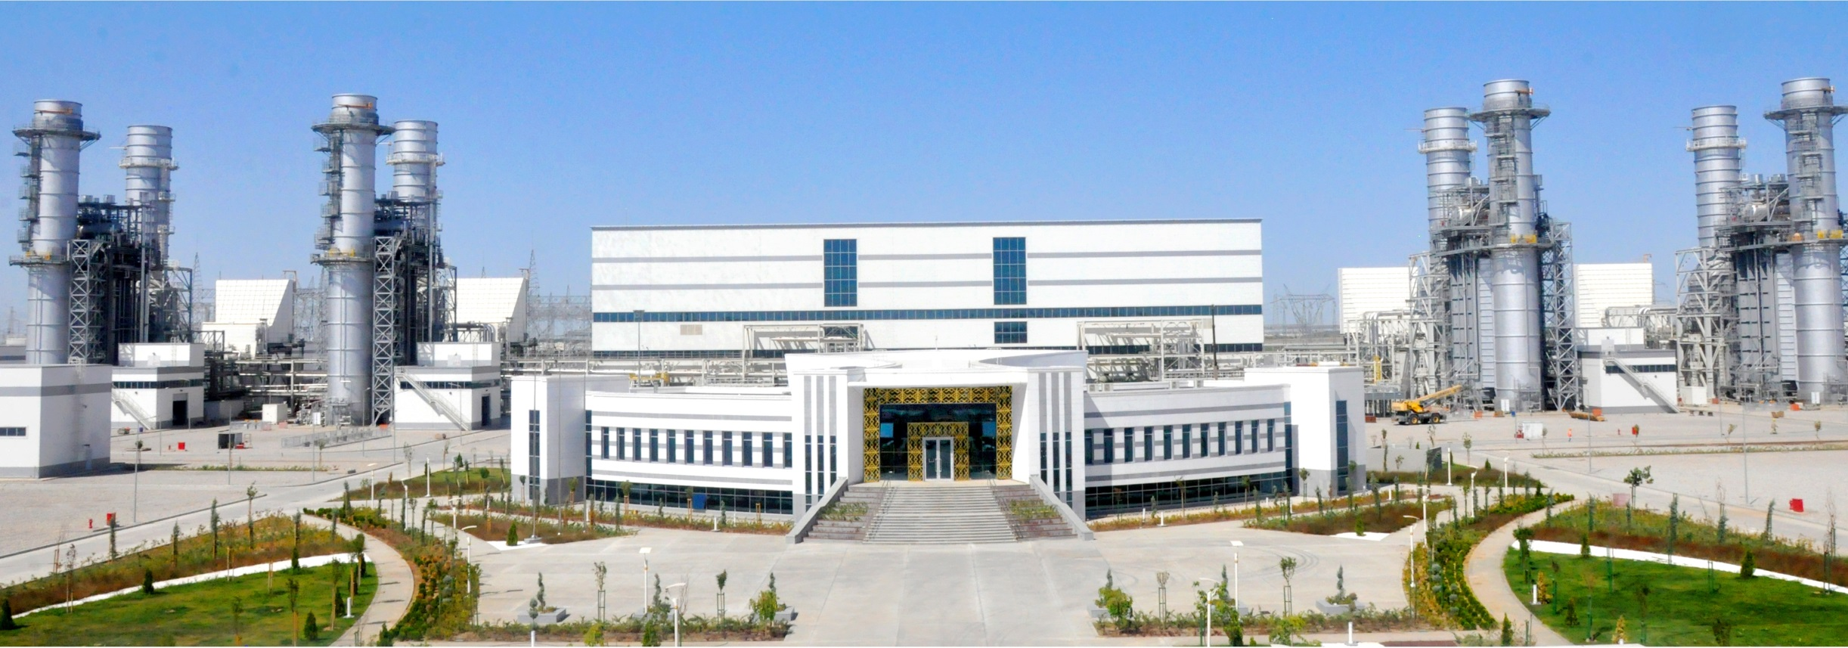
Mary combined cycle power plant
Installed capacity: 1574 MW
Commissioned: September 2018

Slide 4
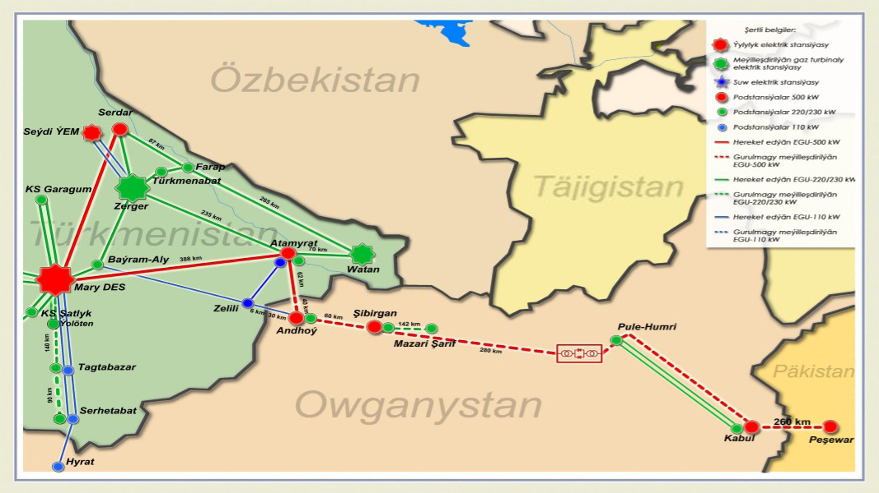

Slide 5
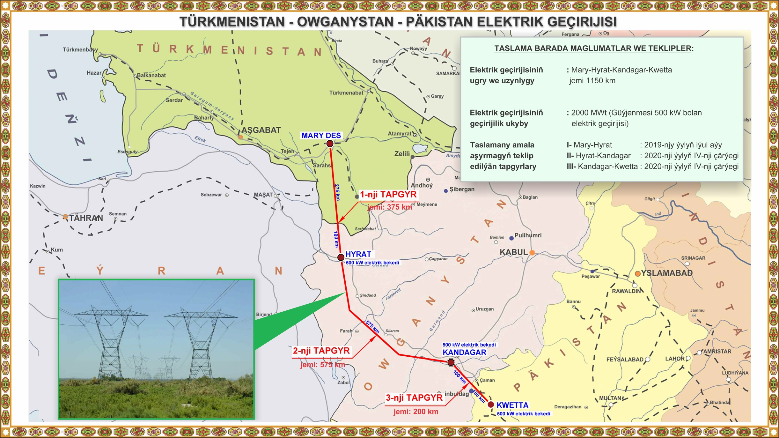
Turkmenistan – Afghanistan – Pakistan 500 kV power transmission line
Total length: 1150 km
Capacity: 2000 MW
(2 lines of 500 kV)
Completion date: 2020-2021

